Slide 1
CS 5683: Algorithms & Methods for Big Data Analytics Finding Similar Items
Arunkumar Bagavathi
Department of Computer Science
Oklahoma State university

Slide 2
Course Topics Until Now
Frameworks
High. Dim. Data
Applications
Map Reduce
Locality Sensitive Hashing
Association Rules
Spark

Slide 3
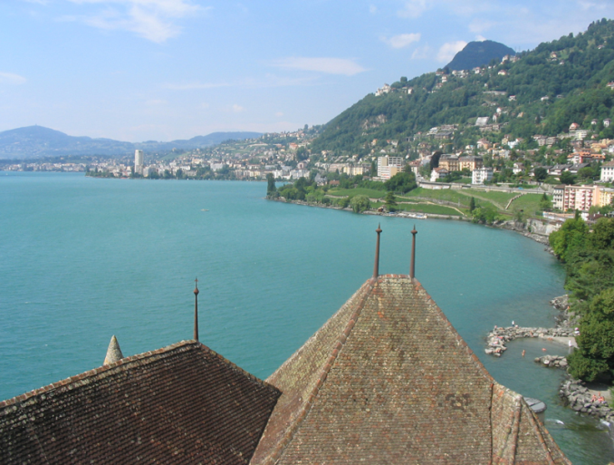

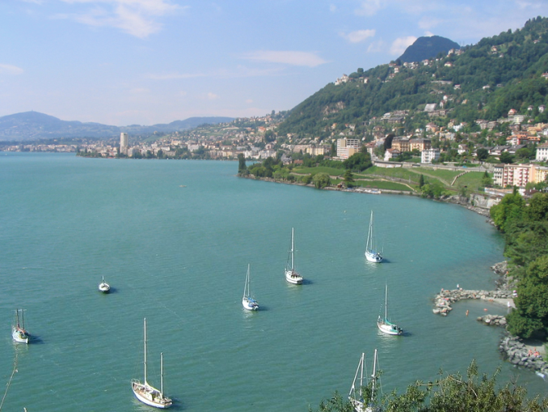
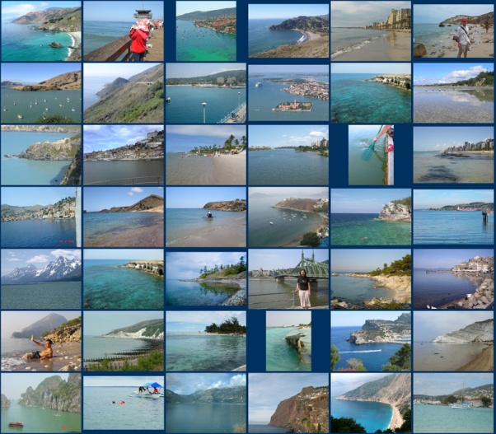
Scene Completion Problem

Slide 4
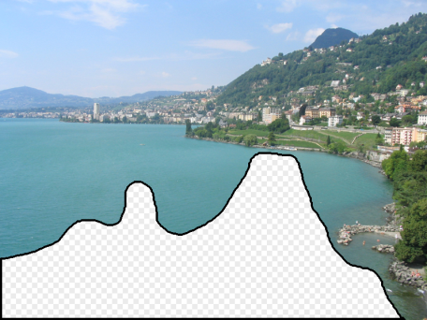
Scene Completion Problem

Slide 5

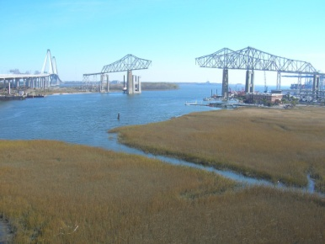


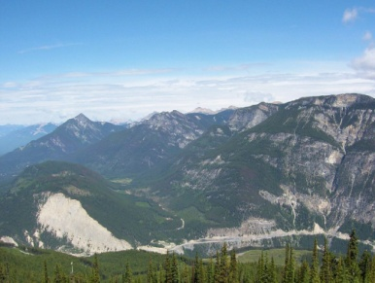
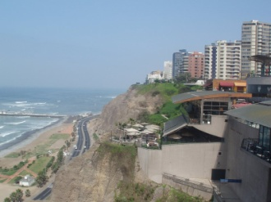
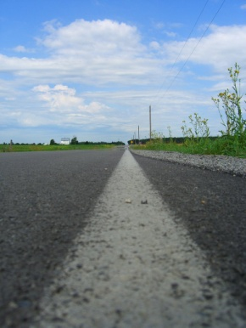

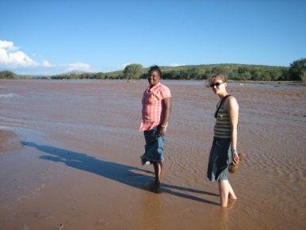

Scene Completion Problem
10 nearest neighbors from a collection of 20,000 images

Slide 6
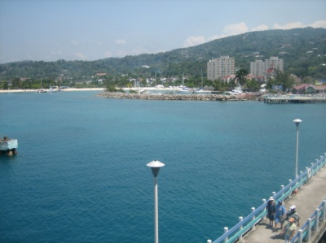
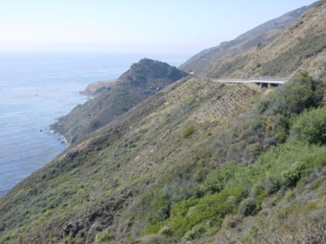
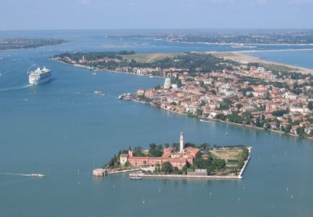
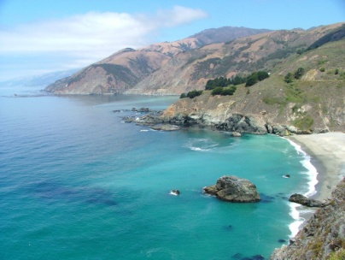

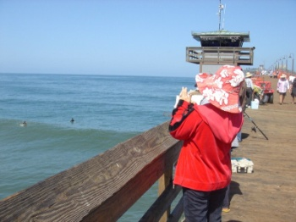
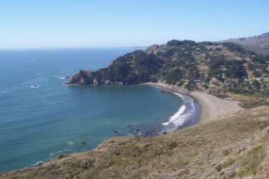
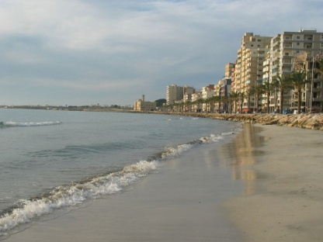

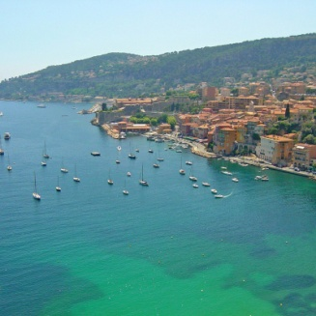
Scene Completion Problem
10 nearest neighbors from a collection of 2 million images

Slide 7
Today’s Lecture
Given: High dimensional data points x₁, x₂,.…
Example: An image (x_{i}) is a long vector of pixel colors
→ [1 2 1 0 2 1 0 1 0]
Add some distance function d(x₁, x₂)
To quantify the “distance” between x₁ and x₂
Goal: Find all pairs of data points (x_{i}, x_{j}) that are within some threshold distance d(x_{i} , x_{j}) ≤ s
Naïve solution complexity? O(N²) ☹ (N is total data points)
Magic: It is possible in O(N). HOW?

Slide 8
Relation to FIM
Last topic: Finding frequent itemset pair!
Items 1…N
Items 1…K
Items 1…K
Items 1…N
Count of pair {i,j} in the data
Count of pair {i,j} in the data
A-Priori:
First pass: Find singleton itemsets (Monotonicity!)
Second pass: Count only candidate pairs!
Naïve solution:
Single pass – but requires memory space quadratic in the number of items
N = number of distinct items
K = number of items with support ≥ s

Slide 9
Relation to Previous Lecture
Last lecture: Finding frequent itemsets
A-Priori refinement: PCY
Pass 1:
Count the frequency of each item
Take pair of items {i,j}, hash them into B buckets, and count the number of pairs that have been hashed to each bucket
Pass 2:
For a pair {i,j} to be a candidate for a frequent pair:
Its singletons {i} and {j} must be frequent
The pair {i,j} has to hash to a frequent bucket
Items 1…N
Buckets 1…B
3 1 2
Basket 1: {1,2,3}
Pairs: {1,2} {1,3} {2,3}
Basket 2: {1,2,4}
Pairs: {1,2} {1,4} {2,4}

Slide 10
Relation to Previous Lecture
Previous lecture: A-Priori and refinements
Main idea: candidates – instead of keeping the count of all item pairs, keep only the count of candidate pairs!
Today’s lecture: Find pairs of similar docs
Main idea: candidates
Pass 1: Take documents and hash them to buckets such that documents that are similar hash to same bucket
Pass 2: Compare only documents that are candidates (i.e) documents that are hashed to a same bucket
Benefits: Instead of making O(N²) comparisons, we need only O(N) comparisons to find similar documents

Slide 11
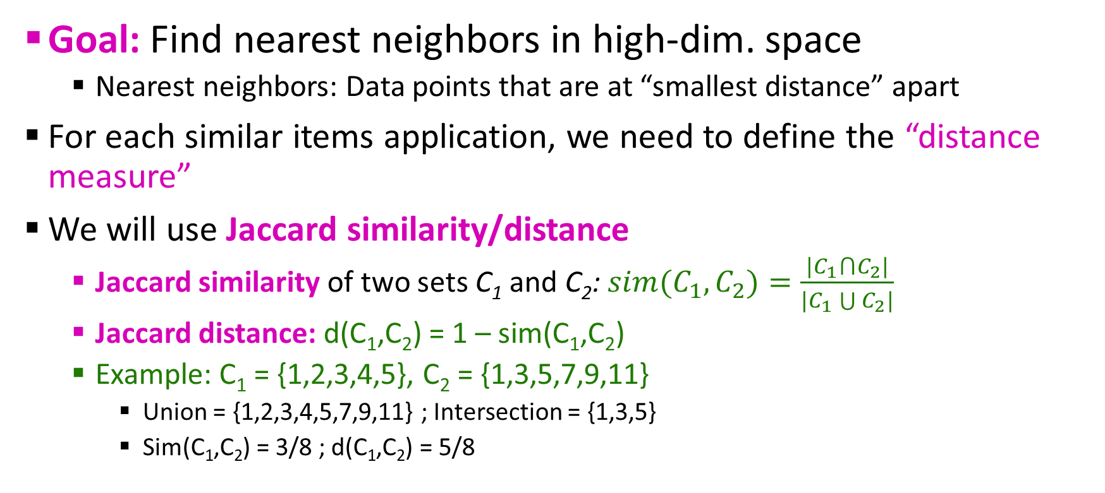
Finding Similar Items
Goal: Find nearest neighbors in high-dim. space
Nearest neighbors: Data points that are at “smallest distance” apart
For each similar items application, we need to define the “distance measure”
We will use Jaccard similarity/distance
Jaccard similarity of two sets C₁ and C₂: $sim(C_{1},C_{2})=\frac{|C_{1}⋂C_{2}|}{|C_{1}\bigcup{C_{2}|}}$
Jaccard distance: d(C₁,C₂) = 1 – sim(C₁,C₂)
Example: C₁ = {1,2,3,4,5}, C₂ = {1,3,5,7,9,11}
Union = {1,2,3,4,5,7,9,11} ; Intersection = {1,3,5}
Sim(C₁,C₂) = 3/8 ; d(C₁,C₂) = 5/8

Slide 12
Task: Finding Similar Documents
Goal: Given a large number (N in millions or billions) of documents, find “near duplicate” pairs
Applications:
Mirrored websites – Don’t want to show both in search results
Similar news articles at many news sources – Cluster news articles of same story
Problems:
Many small pieces of one document can appear out of order in another
Too many documents to compare all pairs
Documents can be so large – may not fit in main memory

Slide 13
Essential Steps for Similar Docs
Shingling – convert documents into sets
Min-Hashing – convert large sets into short signatures, while preserving similarity
Locality Sensitive Hashing – focus on pairs of signatures likely to be from similar documents
Candidate pairs!

Slide 14
Overview
Candidate
pairs:
those pairs
of signatures
that we need
to test for
similarity
Shingling
Min Hashing
Locality-
Sensitive
Hashing
Document
The set
of strings
of length k
that appear
in the doc-
ument
Signatures:
short integer
vectors that
represent the
sets, and
reflect their
similarity

Slide 15
Documents as High Dim. Data
Step 1: Shingling – Convert documents into sets
Simple approaches:
Documents = set of words
Documents = set of “important” words
Doesn’t work well for this application. WHY?
Need to account for ordering of words!
Alternative approach: Shingles!

Slide 16
Shingles
A k-shingle (k-gram) of a document is a sequence of k tokens that appear in the document
Tokens can be characters, words or something else – depending on the application
For our application – tokens = characters
Example:
k=2; document D₁ = abcab
Set of 2-shingles: S(D₁) = {ab,bc,ca}
Option: Shingles can be a bad (multiset) – means count ‘ab’ twice ➔ S(D₁) = {ab,bc,ca,ab}

Slide 17
Working Assumptions
Documents that have lots of shingles in common have similar text, even if the text appears in different order
Caveat: We must pick k large enough – else most of the documents have most shingles
k = 5 for shorter documents
k = 9/10 for longer documents

Slide 18
Compressing Long Shingles
Shingle = set of characters – occupies more memory
Instead we compress long shingles by hashing them to (say) 4 bytes
Thus, we represent each document by a set of hash values of its shingles
IDEA: 2 documents could (rarely) appear to have shingles in common, when only in-fact only the hash-values are shared
Example:
k=2; document D₁ = abcab
Set of 2-shingles: S(D₁) = {ab,bc,ca}
Hash of shingles: h(D₁) = {1,5,7}

Slide 19
Encoding Sets as Bit Vectors
Even hashed 4 bytes shingles can occupy more memory!
Equivalently, each document can be represented as 0/1 vector in the space of k-shingles
Each unique shingle (in the universal set) is a dimension
Encode hashed sets using 0/1 (bit/boolean) vectors
Distance measure is usually done with bitwise set union (OR) and bitwise set intersection (AND)
Example: C₁ = 10111 ; C₂ = 10011
Size of intersection = 3 and size of union = 4
Jaccard similarity = ¾
Jaccard distance = ¼

Slide 20
From Sets to Boolean Matrices
Documents
Rows = elements (shingles)
Columns = sets (documents)
1 in row e and column s if and only if e is a member of s
Document similarity is the Jaccard similarity of the corresponding columns (rows with value 1)
Example: sim(C₁,C₂) = ?
Size of intersection = 3 ; Size of union = 6
Jaccard similarity = ½
Jaccard distance = ½
1
1
1
0
1
1
0
1
0
1
0
1
0
0
0
1
Shingles
1
0
0
1
1
1
1
0
1
0
1
0
Input Matrix

Slide 21
Outline: Finding Similar Columns
Shingling
So far:
Documents → Sets of shingles
Represent hashed sets as boolean vectors in a matrix
But, this matrix will be sparse!
Occupies more memory
Next goal:
Generate signatures for large sets
Find similar columns while computing small signatures
Similarity of columns == similarity of signatures
Document
The set
of strings
of length k
that appear
in the doc-
ument

Slide 22
Outline: Finding Similar Columns
Next goal: Find similar columns, Small signatures
Naïve approach:
Signatures of columns: small summaries of columns
Examine pairs of signatures: to find similar columns
Similarities of signatures and columns are related
Optional: Check that columns with similar signatures are really similar
Warning: Checking all pairs take long time – Job for LSH

Slide 23
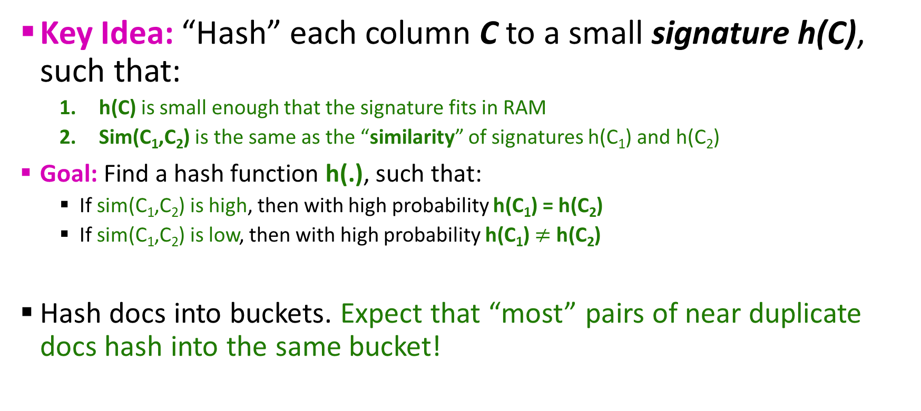
Hashing Columns (Signatures)
Key Idea: “Hash” each column C to a small signature h(C), such that:
h(C) is small enough that the signature fits in RAM
Sim(C₁,C₂) is the same as the “similarity” of signatures h(C₁) and h(C₂)
Goal: Find a hash function h(.), such that:
If sim(C₁,C₂) is high, then with high probability h(C₁) = h(C₂)
If sim(C₁,C₂) is low, then with high probability h(C₁) $≠$ h(C₂)
Hash docs into buckets. Expect that “most” pairs of near duplicate docs hash into the same bucket!

Slide 24
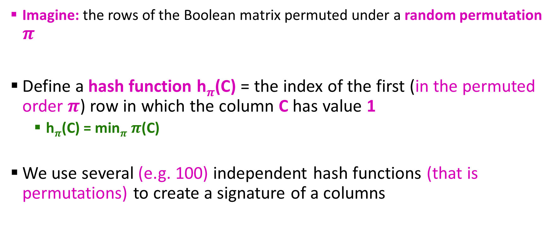
Min-Hashing
Imagine: the rows of the Boolean matrix permuted under a random permutation $π$
Define a hash function h$π$(C) = the index of the first (in the permuted order $π$) row in which the column C has value 1
h$π$(C) = min$π$ $π$(C)
We use several (e.g. 100) independent hash functions (that is permutations) to create a signature of a columns

Slide 25
Min-Hashing Example
2nd element of the permutation is the first to map to a 1
Permutation π
Input matrix (Shingles x Documents)
Signature matrix M
2
4
3
4
7
2
6
1
5
1
0
1
0
2
1
2
1
3
2
1
0
0
1
2
1
4
1
7
1
0
1
0
1
1
2
1
2
6
3
0
1
0
1
1
6
0
1
0
1
4th element of the permutation is the first to map to a 1
5
7
1
0
1
0
4
5
1
0
1
0

Slide 26
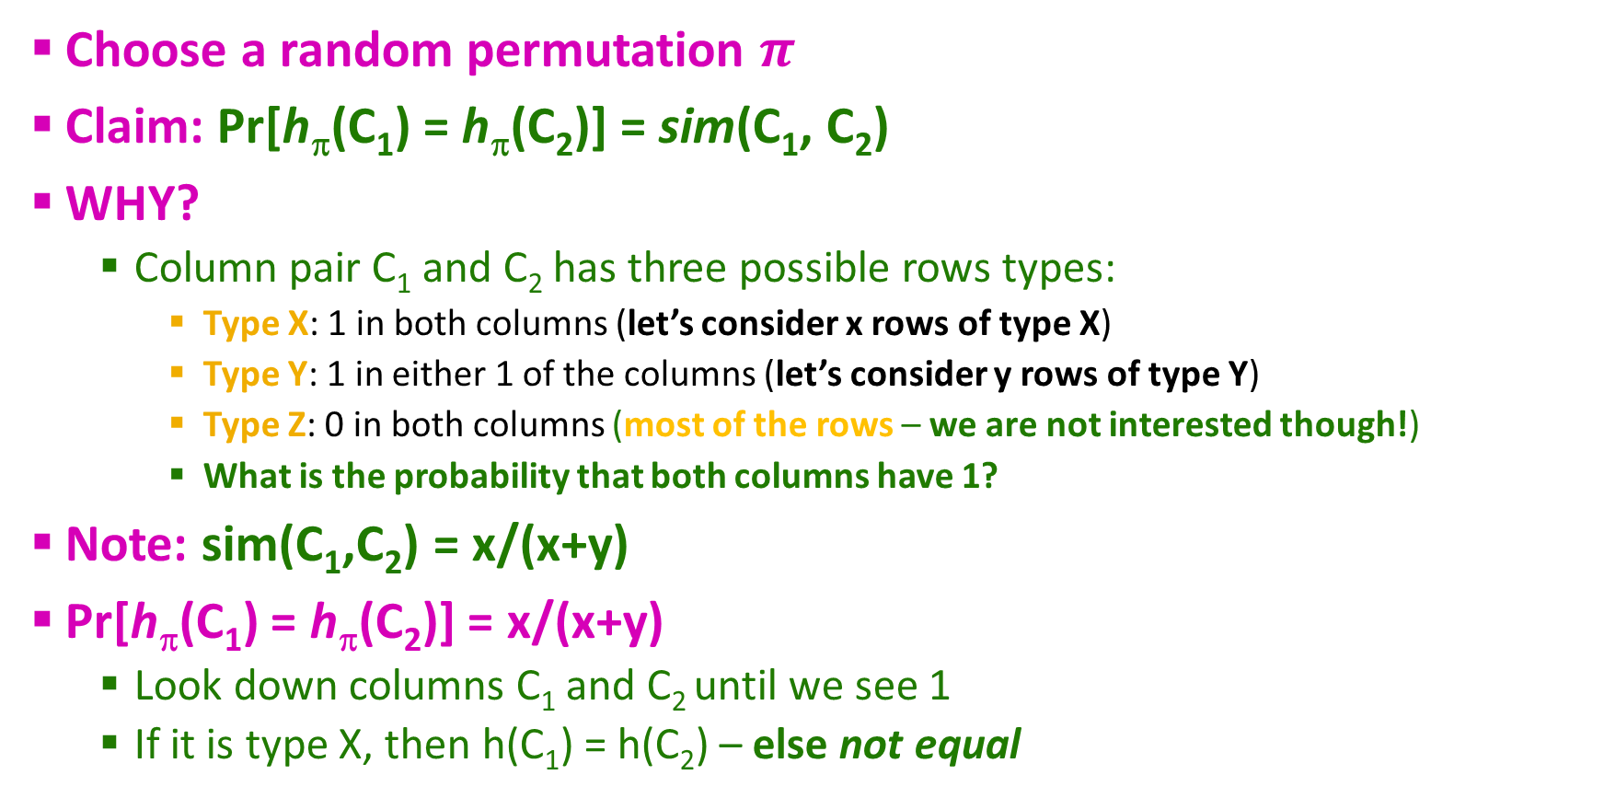
The Min-Hash Property
0
0
0
0
Choose a random permutation $π$
Claim: Pr[h_{π}(C₁) = h_{π}(C₂)] = sim(C₁, C₂)
WHY?
Column pair C₁ and C₂ has three possible rows types:
Type X: 1 in both columns (let’s consider x rows of type X)
Type Y: 1 in either 1 of the columns (let’s consider y rows of type Y)
Type Z: 0 in both columns (most of the rows – we are not interested though!)
What is the probability that both columns have 1?
Note: sim(C₁,C₂) = x/(x+y)
Pr[h_{π}(C₁) = h_{π}(C₂)] = x/(x+y)
Look down columns C₁ and C₂ until we see 1
If it is type X, then h(C₁) = h(C₂) – else not equal
1
1
0
0
0
1
1
0
C₁
C₂

Slide 27
Similarity of Signatures
We know Pr[h_{π}(C₁) = h_{π}(C₂)] = sim(C₁, C₂)
Let’s generalize to multiple hash functions!
The similarity of two signatures is the fraction of the hash functions in which they agree
Thus, the expected similarity of two signatures equals the Jaccard similarity of columns/docs that the signatures represent
Longer the signatures, smaller will be the expected error

Slide 28
Min-Hashing Example
Permutation π
Input matrix (Shingles x Documents)
Signature matrix M
2
4
3
4
7
2
6
1
5
1
0
1
0
2
1
2
1
3
2
1
0
0
1
2
1
4
1
7
1
0
1
0
1
1
2
1
2
6
3
0
1
0
1
1
6
0
1
0
1
Similarities:
1-3 2-4 1-2 3-4
Col/Col 0.75 0.75 0 0
Sig/Sig 0.67 1.00 0 0
5
7
1
0
1
0
4
5
1
0
1
0

Slide 29
Min-Hash Signatures Overview
Pick K=100 random permutations of the rows
Think of sig(C) as a column vector
sig(C)[i] = according to the i^{th} permutation, the index of the first row that has a 1 in column C
Note: The signature vector of document C is significantly smaller that of the Boolean vector
We achieved our goal! We “compressed” long bit vectors into short signatures

Slide 30
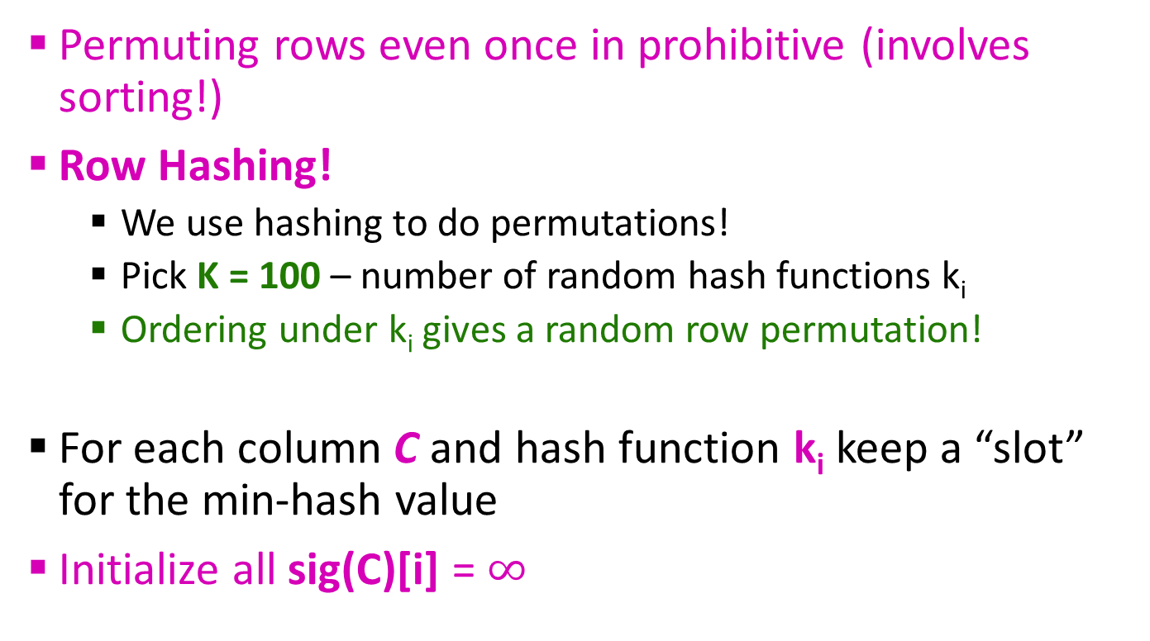
Min-Hashing Implementation Trick
Permuting rows even once in prohibitive (involves sorting!)
Row Hashing!
We use hashing to do permutations!
Pick K = 100 – number of random hash functions k_{i}
Ordering under k_{i} gives a random row permutation!
For each column C and hash function k_{i} keep a “slot” for the min-hash value
Initialize all sig(C)[i] = $∞$
How to pick a random hash function h(x)?
Universal hashing:
h_{a,b}(X) = ((a.x + b) mod p) mod N
where:
a,b are random integers
N = number of input matrix rows
p = prime number ; p > N

Slide 31
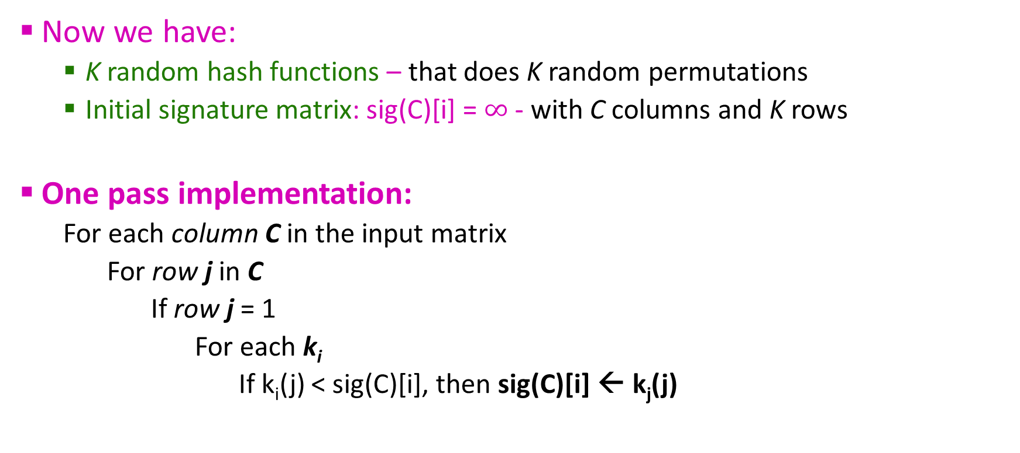
Min-Hashing Implementation Trick
Now we have:
K random hash functions – that does K random permutations
Initial signature matrix: sig(C)[i] = $∞$ - with C columns and K rows
One pass implementation:
For each column C in the input matrix
For row j in C
If row j = 1
For each k_{i}
If k_{i}(j) < sig(C)[i], then sig(C)[i] ← k_{j}(j)

Slide 32
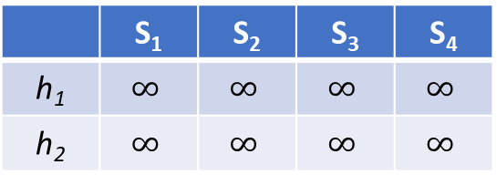
Min-Hashing Implementation Example
Input matrix
Row | S₁ | S₂ | S₃ | S₄ |  | x + 1 mod 5 | 3x + 1 mod 5
0 | 1 | 0 | 0 | 1 |  | 1 | 1
1 | 0 | 0 | 1 | 0 |  | 2 | 4
2 | 0 | 1 | 0 | 1 |  | 3 | 2
3 | 1 | 0 | 1 | 1 |  | 4 | 0
4 | 0 | 0 | 1 | 0 |  | 0 | 3
Signature matrix
 | S₁ | S₂ | S₃ | S₄
h₁ | $$∞$$ | $$∞$$ | $$∞$$ | $$∞$$
h₂ | $$∞$$ | $$∞$$ | $$∞$$ | $$∞$$

Slide 33
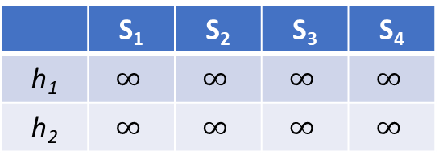
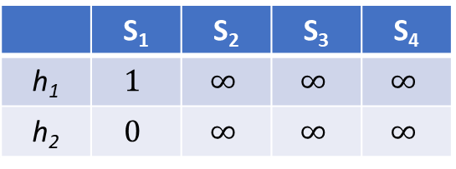
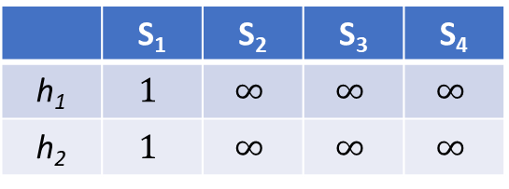
Min-Hashing Implementation Example
Input matrix
Row | S₁ | S₂ | S₃ | S₄ |  | x + 1 mod 5 | 3x + 1 mod 5
0 | 1 | 0 | 0 | 1 |  | 1 | 1
1 | 0 | 0 | 1 | 0 |  | 2 | 4
2 | 0 | 1 | 0 | 1 |  | 3 | 2
3 | 1 | 0 | 1 | 1 |  | 4 | 0
4 | 0 | 0 | 1 | 0 |  | 0 | 3
Signature matrix
 | S₁ | S₂ | S₃ | S₄
h₁ | $$∞$$ | $$∞$$ | $$∞$$ | $$∞$$
h₂ | $$∞$$ | $$∞$$ | $$∞$$ | $$∞$$
Signature matrix – S₁ and row 0
Signature matrix – S₁ and row 3
 | S₁ | S₂ | S₃ | S₄
h₁ | $$1$$ | $$∞$$ | $$∞$$ | $$∞$$
h₂ | $$1$$ | $$∞$$ | $$∞$$ | $$∞$$
 | S₁ | S₂ | S₃ | S₄
h₁ | $$1$$ | $$∞$$ | $$∞$$ | $$∞$$
h₂ | $$0$$ | $$∞$$ | $$∞$$ | $$∞$$

Slide 34
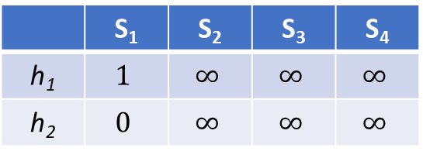
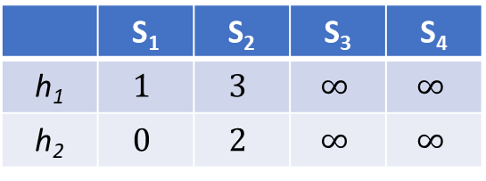
Min-Hashing Implementation Example
Input matrix
Row | S₁ | S₂ | S₃ | S₄ |  | x + 1 mod 5 | 3x + 1 mod 5
0 | 1 | 0 | 0 | 1 |  | 1 | 1
1 | 0 | 0 | 1 | 0 |  | 2 | 4
2 | 0 | 1 | 0 | 1 |  | 3 | 2
3 | 1 | 0 | 1 | 1 |  | 4 | 0
4 | 0 | 0 | 1 | 0 |  | 0 | 3
Signature matrix
 | S₁ | S₂ | S₃ | S₄
h₁ | $$1$$ | $$∞$$ | $$∞$$ | $$∞$$
h₂ | $$0$$ | $$∞$$ | $$∞$$ | $$∞$$
Signature matrix – S₂ and row 2
 | S₁ | S₂ | S₃ | S₄
h₁ | $$1$$ | $$3$$ | $$∞$$ | $$∞$$
h₂ | $$0$$ | $$2$$ | $$∞$$ | $$∞$$

Slide 35
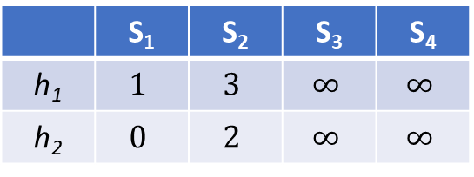
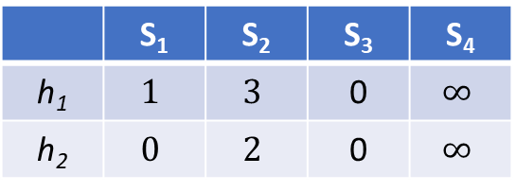
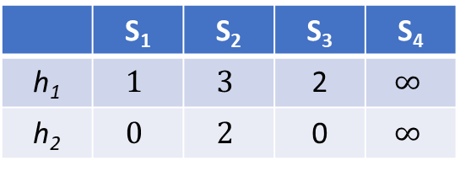
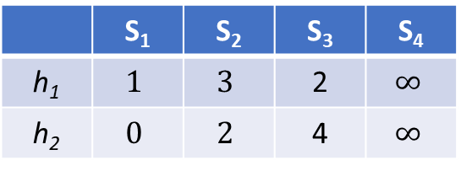
Min-Hashing Implementation Example
Input matrix
Row | S₁ | S₂ | S₃ | S₄ |  | x + 1 mod 5 | 3x + 1 mod 5
0 | 1 | 0 | 0 | 1 |  | 1 | 1
1 | 0 | 0 | 1 | 0 |  | 2 | 4
2 | 0 | 1 | 0 | 1 |  | 3 | 2
3 | 1 | 0 | 1 | 1 |  | 4 | 0
4 | 0 | 0 | 1 | 0 |  | 0 | 3
Signature matrix
 | S₁ | S₂ | S₃ | S₄
h₁ | $$1$$ | $$3$$ | $$∞$$ | $$∞$$
h₂ | $$0$$ | $$2$$ | $$∞$$ | $$∞$$
Signature matrix – S₂ and row 1
Signature matrix – S₂ and row 3
Signature matrix – S₂ and row 4
 | S₁ | S₂ | S₃ | S₄
h₁ | $$1$$ | $$3$$ | 2 | $$∞$$
h₂ | $$0$$ | $$2$$ | 4 | $$∞$$
 | S₁ | S₂ | S₃ | S₄
h₁ | $$1$$ | $$3$$ | 2 | $$∞$$
h₂ | $$0$$ | $$2$$ | 0 | $$∞$$
 | S₁ | S₂ | S₃ | S₄
h₁ | $$1$$ | $$3$$ | 0 | $$∞$$
h₂ | $$0$$ | $$2$$ | 0 | $$∞$$

Slide 36
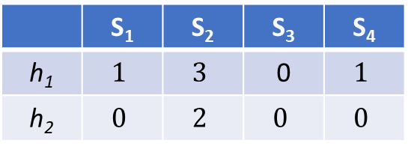
Min-Hashing Implementation Example
Input matrix
Row | S₁ | S₂ | S₃ | S₄ |  | x + 1 mod 5 | 3x + 1 mod 5
0 | 1 | 0 | 0 | 1 |  | 1 | 1
1 | 0 | 0 | 1 | 0 |  | 2 | 4
2 | 0 | 1 | 0 | 1 |  | 3 | 2
3 | 1 | 0 | 1 | 1 |  | 4 | 0
4 | 0 | 0 | 1 | 0 |  | 0 | 3
Signature matrix
 | S₁ | S₂ | S₃ | S₄
h₁ | $$1$$ | $$3$$ | 0 | $$1$$
h₂ | $$0$$ | $$2$$ | $$0$$ | $$0$$
Compare Jaccard similarity of column pairs in input matrix and signature matrix

Slide 37
Locality Sensitive Hashing
Candidate
pairs:
those pairs
of signatures
that we need
to test for
similarity
Shingling
Min-Hash-
ing
Locality-
Sensitive
Hashing
Document
The set
of strings
of length k
that appear
in the doc-
ument
Signatures:
short integer
vectors that
represent the
sets, and
reflect their
similarity
Locality Sensitive Hashing
Comparing similarity of every pair is complex – even with the signature matrix!
Focus only on pairs of signatures (candidates) that likely to form similar documents

Slide 38
LSH: First Cut
Goal: Find documents with Jaccard similarity at least s (for some threshold s = 0.8)
LSH – General Idea: Use a function f(x,y) that tells whether x and y is a candidate pair: a pair of documents which have potential to be similar
For Min-Hash matrix:
Hash columns of the signature matrix M to many buckets
Each pair of documents that hashes into the same bucket is a candidate pair

Slide 39
Candidates from Min-Hash
Pick a similarity threshold s (o < s <1)
Columns x and y of M are a candidate pair if their signatures agree on at least fraction s of their rows:
M(i,x) = M(i,y) for at least fraction s values of i
We expect documents x and y to have the same similarity as their signatures

Slide 40
LSH for Min-Hash
Big Idea: Hash columns of signature matrix M several times
“Hash” in such a way that similar items (columns) are more likely hash to the same bucket than dissimilar columns
Reduce the fraction of false positives and false negatives
Candidate pairs are those that hash to the same bucket

Slide 41
Partition M into Bands
r rows
per band
b bands
One
signature
Signature matrix M

Slide 42
Partition M into Bands
Divide the signature matrix M into b bands of r rows
For each band, hash its portion of each column to a hashtable with k buckets
Make k as large as possible
We can use same hash function for all bands – but different bucket array
Candidate column pairs are those that hash to the same bucket for ≥ 1 band
Tune b and r to catch most similar pairs, but few dissimilar pairs

Slide 43
Hashing Bands
Buckets
Columns 6 and 7 are
surely different.
Matrix M
r rows
b bands

Slide 44
Simplifying Assumptions
We create enough buckets that columns are unlikely to hash to the same bucket unless they are identical in a particular band
Hereafter, we assume that “same bucket” means “identical in that band”

Slide 45
Example of Bands
Assume the following:
100k docs signature matrix – 100,000 columns
Signatures of 100 integers – 100 rows
Thus, signature matrix take 40Mb
Easy to fit in memory
Choose b = 20 bands of r = 5 integers/band
Goal: Find pairs of documents that are at least s = 0.8 similar

Slide 46
Prob. of b bands and r rows/band
Assume: Columns C₁ and C₂ have similarity t
Pick any one band (with r rows)
Prob. that all rows are equal = t^{r}
Prob. that at least one row is unequal = 1 – t^{r}
Prob. that at least one row is unequal in all bands (no band is identical) = (1 - t^{r})^{b}
Prob. that at least one band is identical = 1 - (1 - t^{r})^{b}

Slide 47
Assume C₁ and C₂ are 80% similar
Assumption: sim(C₁,C₂) = 0.8; b=20 and r=5
Since sim(C₁,C₂) >= 0.8, we want C₁,C₂ to be a candidate pair – meaning that we want to hash both C₁ and C₂ to at least 1 common bucket (at least 1 band is identical)
Probability that C₁ and C₂ are identical in one particular band with 5 rows = (0.8)⁵ = 0.328
Probability that C₁ and C₂ are not identical in all of 20 bands = (1-0.328)²⁰ = 0.00035
i.e. about 1/3000th of 80% similar column pairs are false negatives (we will miss them)
But, we catch 99.965% truly similar document pairs

Slide 48
Assume C₁ and C₂ are 30% similar
Assumption: sim(C₁,C₂) = 0.3; b=20 and r=5
Since sim(C₁,C₂) < s (0.8), we want C₁,C₂ to hash to NO common buckets (hash of these column pairs from all bands should be different)
Probability that C₁ and C₂ are identical in one particular band with 5 rows = (0.3)⁵ = 0.00243
Probability that C₁ and C₂ are identical in at least 1 of 20 bands = 1 - (1-0.00243)²⁰ = 0.0474
i.e. 4.74% pairs of documents with similarity 0.3% end up as candidate pairs
We will eliminate false positives by examining Jaccard similarity of C₁ and C₂

Slide 49
LSH Tradeoff
We make the following assumptions to balance between false positives and false negatives
The number of min-hashes (rows of M)
The number of bands (b)
The number of rows per band (r)
Example: If we use 15 bands of 5 rows, the number of false positives would go down, but the number of false negatives would go up

Slide 50
Analysis of LSH – What We Want
Probability = 1 if t > s
Probability
of sharing
a bucket
No chance
if t < s
Similarity threshold s
Similarity t =sim(C₁, C₂) of two sets

Slide 51
What b Bands of r Rows Gives US
No bands
identical
At least
one band
identical
(
)^{b}
Probability
of sharing
a bucket
t ~ (1/b)^{1/r}
1 -
1 -
t ^{r}
All rows
of a band
are equal
Some row
of a band
unequal
Similarity t=sim(C₁, C₂) of two sets
We choose the similarity threshold s = t (Approximated as a function of b and r)

Slide 52
Example: b = 20; r = 5
Similarity threshold s
Prob. that at least 1 band is identical:
s | 1-(1-s^{r})^{b}
.2 | .006
.3 | .047
.4 | .186
.5 | .470
.6 | .802
.7 | .975
.8 | .9996

Slide 53
Picking r and b: The S-curve
Picking r and b to get the best S-curve
50 hash functions (r=5; b=10)
Prob. sharing a bucket
Blue area: False Negative rate
Green area: False Positive rate
Similarity
Visualizing the effect of t, b, r in the S-Curve: https://www.desmos.com/calculator/lzzvfjiujn

Slide 54
LSH Summary
Tune M, b, r to get almost all pairs with similar signatures, but eliminate most pairs with dissimilar signatures
Check in the main-memory that candidate pairs really do have similar signatures
Optional: In another pass through data, check that the candidate pairs which have similar signatures really represent similar documents

Slide 55
LSH Summary – 3 Steps
Shingling: Convert documents to sets
We used hashing to assign each shingle an ID
Min-Hashing: Convert large sets to short signatures, while preserving similarities
We used similarity preserving hashing to generate signatures with property Pr[h_{π}(C₁) = h_{π}(C₂)] = sim(C₁, C₂)
We used hashing to get around generating random permutations
Locality Sensitive Hashing: Focus on pairs of signatures likely to be from similar documents
We used hashing to find candidate pairs of similarity ≥ s

Slide 56
Distance Measures
Generalized LSH is based on some kind of “distance” between points.
Similar points are “close”
Example: Jaccard similarity is not a distance; 1 minus Jaccard similarity is
Classes of distance measures
Euclidean
Non-Euclidean

Slide 57
Euclidean Vs. Non-Euclidean
A Euclidean space has some real-valued number of dimensions and dense points
There is a notion of “average” location of points
A Euclidean distance is based on locations of points in a Euclidean space
Any other space is Non-Euclidean space
Distance measures for non-Euclidean spaces are properties of points, but not their ‘location’ in the space

Slide 58
Axioms of a Distance Measure
d(.) is a distance measure if it is a function from pairs of points to real numbers such that:
d(x,y) > 0
d(x,y) = 0 iff x = y
d(x,y) = d(y,x)
d(x,y) < d(x,z) + d(z,y) (triangle inequality)

Slide 59
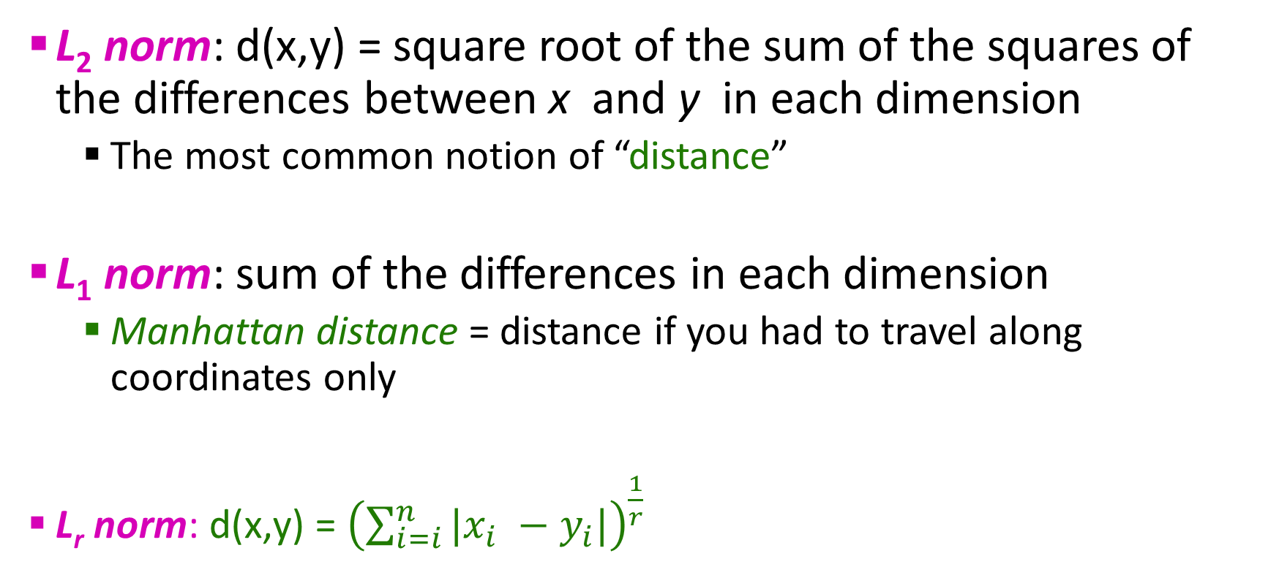
Some Euclidean Distances
L₂ norm: d(x,y) = square root of the sum of the squares of the differences between x and y in each dimension
The most common notion of “distance”
L₁ norm: sum of the differences in each dimension
Manhattan distance = distance if you had to travel along coordinates only
L_{r} norm: d(x,y) = ${\left(\sum_{i=i}^{n}{|x_{i} −y_{i}|}\right)}^{\frac{1}{r}}$

Slide 60
Some Non-Euclidean Distances
Jaccard distance for sets = 1 – Jaccard similarity
Cosine distance for vectors = angle between the vectors
Edit distance for strings = number of inserts and deletes to change one string into another

Slide 61

Questions???

Slide 62
Acknowledgements
Most of this lecture slides are obtained from the Mining Massive Datasets course: http://www.mmds.org/

